Slide 1
Hiring for 2055:
Building a Diverse Faculty,
One Search at a Time
NCORE 2021

Slide 2
Year 2055

Slide 3
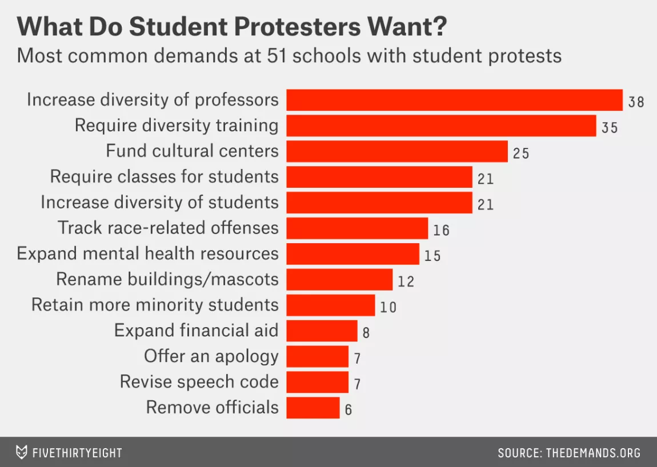
What Do Student Activists Want?

Slide 4
U.S. Student Demographic Projections
Notes:
http://www.census.gov/population/projections/data/national/2014/summarytables.html
https://www.americanprogress.org/wp-content/uploads/issues/2011/10/pdf/progress_2050.pdf
This is based on total U.S. population
Caucasian Whites will drop from around 75% to 46%
Hispanics will rise to roughly 30%
Asians will rise to roughly 8%
Blacks will increase slightly from 13-15%
Native Americans and Pacific Islanders will stay steady at around 1%

Slide 5
“Every system is perfectly designed to get the results it gets.”
Notes:
Credit: Paul Batalden (used widely in health care improvement community).

Slide 6
PWI University Demographic Data Definitions
Underrepresented Minority (URM): Domestic racial and ethnic populations that are underrepresented at the college/university relative to their numbers in the general U.S. domestic population.
Black/African American
Hispanic/Latinx: Cuban/Mexican/Puerto Rican, South or Central American
Native American/Alaska Native
Pacific Islander/Native Hawaiian
Faculty of Color
URM groups + Middle Eastern descent + Asian American

Slide 7
PWIU Underrepresented (URM) Tenure Track/Tenured Faculty
Notes:
30 out of 150 T/TT faculty members

Slide 8
If PWIU Tenure Track/Tenured Faculty matched the 2020 Census…

Slide 9
PWIU URM Tenure Track/Tenured Faculty by Department
Notes:
15 out of 26 departments without any URM Tenure/Tenure Track faculty.

Slide 10
PWIU URM + Faculty of Color Tenure Track/Tenured Faculty by Department
Notes:
10 out of 26 departments without any URM or Faculty of Color Tenure/Tenure Track Faculty
14 out of 26 departments with only 1 or no URM or Faculty of Color Tenure/Tenure Track Faculty

Slide 11
PWIU URM + Faculty of Color Tenure Track/Tenured Faculty

Slide 12
2010-2020 Underrepresented (URM) TT Faculty
Notes:
Out of 100%

Slide 13
To change the outcome, you have to change the process.
Tenure track faculty are a major, long term investment. If you wouldn’t build a building with 0-3 months of preparation, don’t do a tenure track search with that kind of prep either. At least 2 years of preparation before a search goes public is ideal, and 1 year is essential.
To increase success, look across time, not just across space (Faculty Target of Opportunity Hires).

Slide 14
Search Phases
Preparatory Phase 1: Strategic Planning
Preparatory Phase 2: Nuts & Bolts
Public Phase: Evaluation & Hiring
Activities in Breakout Rooms

Slide 15
Overall Search Goal
1) New colleague with requisite technical skills
2) New colleague who compliments your existing strengths along as many axes as possible including:
Curricular diversity
Embodied diversity
Knowledge of and experience with inclusive practices in the classroom and workplace
Culturally responsive communication and engagement skills

Slide 16
Year 1, Preparatory Phase: Strategic Planning
Build a long-term strategic plan for your department or program:
What areas of study within your discipline are likely to grow and be most resilient over time? Give specific consideration to scholarship from the vantage point of marginalized populations.
Who are you educating now? Who will you be educating in 10 years? 20 years? How will your department’s offerings be most responsive to and effective for these students?

Slide 17
Year 2, Preparatory Phase: Nuts & Bolts
Create an expansive and flexible vision of what you want in your next Tenure Track hire
Anticipate forms of bias
Actively construct a deep and diverse applicant pool

Slide 18
Year 2, Preparatory Phase: Create an expansive and flexible vision
Your goal is for your new hire to bring new insights and skills that will guide your department in the coming decades. Stay away from the model of hiring a clone of the person now occupying the faculty line.
Outline the position as broadly as possible. How far can you stretch for a great candidate? How might you adjust future positions to accommodate particular candidates in this search?
How will you structure mentoring your new hire as an important and valued department responsibility? Who will mentor and how will they receive credit?
What other investments is your department prepared to make for your new hire?
ACTIVITY 1

Slide 19
Year 2, Preparatory Phase: Anticipate Forms of Bias
We all have implicit biases that come with being human. We work to mitigate bias as a team. We begin by identifying common types of bias:
Familiarity
Less Work for Me
Search as Sieve
Apples and Oranges
ACTIVITY 2

Slide 20
Year 2, Preparatory Phase: Building a Diverse Candidate Pool
Let the department or committee talk about how hard it is to find candidates from underrepresented groups in their particular discipline, BUT ONLY FOR 10 MINUTES. Then get on with it.
ACTIVITY 3

Slide 21
Year 2, Preparatory Phase: Building a Diverse Candidate Pool
Start identifying potential candidates from as many sources as possible. List every avenue you can pursue to identify potential candidates.
Grad schools, post-docs, conferences, colleagues, professional development programs for URM’s, pipeline projects, etc.
Be specific. Who will contact whom? Who will follow up on leads? Who will keep the database and remind people of their commitments?
Engage with potential candidates and invite to campus if possible.
ACTIVITY 4

Slide 22
Year 2, Preparatory Phase: Building a Diverse Candidate Pool
By the time the search goes public, the search committee should have 20 names of promising URM candidates that they can personally invite to apply for the job. Invite early and follow through.
For an exceptionally promising candidate, petition your administration to hire via a Target of Opportunity or Diversity Hiring mechanism

Slide 23
Year 2, Preparatory Phase: Creating the Job Description
Job ad language should be worded as broadly as possible while meeting the department’s or program’s needs. Ad should require a statement on how applicant will contribute to the college’s commitment to diversity and inclusion including applicant’s knowledge of and experience with inclusive pedagogical practices in classroom teaching, advising, and mentoring.

Slide 24
Year 2, Preparatory Phase: Creating the Search Committee
Composition of the search committee should include at least 2 Diversity Advocates whose job on the committee is to help the committee prioritize hiring a diverse candidate and on minimizing unconscious bias in the search process.
Provide training for the Chair of the search committee, the Diversity Advocates, and the whole committee

Slide 25
Year 3, Public Phase 1: Before opening files
Before anyone opens a file, the committee meets:
Reiterate commitment to hiring a diverse faculty.
Have committee read, then discuss literature on unconscious bias in hiring. Agree on mechanisms to identify and correct for the inevitable biases that creep into deliberations.
Remember, mitigating bias is a group endeavor, not a blame/shame game.

Slide 26
Year 3, Public Phase 1: Before opening files
Have the committee write a list of evaluation criteria including essential criteria, highly desirable criteria, and hidden criteria.
ALL FILES WILL BE EVALUATED AGAINST THE ESSENTIAL AND HIGHLY DESIRABLE CRITERIA.
ACTIVITY 5

Slide 27
Year 3, Public Phase 1: Evidence-based evaluation of candidates
From this point forward, your goal is to collect evidence that candidates do or do not meet your criteria.
Create an evidence rubric for each criteria
Don’t eliminate candidates for evidence you do not yet have
Don’t use proxies

Slide 28
Year 3, Public Phase 2: Towards A Short List
All files vetted by at least two committee members.
Read beyond the cover letters for evidence of a passion for teaching. Candidates can get bad advice from R1 research advisors.
Don’t privilege candidates who attended a similar type of institution as yours.
You are looking for LONG TERM promise, not someone to cover next year’s course listings. Consider investing time, resources, and mentorship in less seasoned, but very promising candidates who would add multiple new dimensions to your department/program.
Use the mechanisms you developed in Phase 1 to challenge unconscious bias in deliberations.

Slide 29
Year 3, Public Phase 3: Preliminary Interviews
Committee meets again to discuss interview protocol. Don’t do illegal or off-putting things.
The preliminary interviewees should ideally include at least 4-5 members of underrepresented groups.
Interviews are a two-way street. The candidates are also evaluating you.
Have a diverse delegation (in gender and ethnicity) represent the committee
If the finalist pool resulting from this process is not diverse, consider continuing the search in the next academic year.

Slide 30
Year 3, Public Phase 4: Campus Interviews
Ask the Dean to bring in 4 or 5 on–campus candidates if it significantly increases the diversity of your finalist pool.
Communicate all the ways in which you plan to support the candidate in terms of resources, professional development, mentoring, etc.
Follow the candidate’s lead on explicit interests in diversity and inclusion work. Include appropriate faculty and staff in interviews and/or dinner.
Talk up your town.

Slide 31
Year 3, Public Phase 5: Ranking the Candidates
Reiterate the commitment to hiring a diverse faculty.
Consider feedback rubrics for faculty and student feedback.
See example of recommendations for student feedback

Slide 32
Year 3, Public Phase 5: Ranking the Candidates
Remember that you are looking for LONG TERM promise, not someone to cover next year’s course listings. Consider investing time, resources, and mentorship in less seasoned, but very promising candidates who would add multiple new dimensions to your department/program.
How far can you stretch for a great candidate? How might you adjust future positions to accommodate particular candidates in this search?

Slide 33
Year 3, Public Phase 6: Making the Offer
Hire for 2055.

Slide 34
Changing the process, changes the outcomes!
Faculty of Color and/or Women in STEM Hires at Reed
 | # of Total Hires | % of Hires were FoC and/or Women in STEM
2011-2020 | 57 | 63.2%
2002-2011 | 51 | 19.6%

Slide 35
Next Steps
Of the strategies you learned about today, identify 3 that you would like to implement in your next search.
For each strategy, identify what is your VERY NEXT STEP necessary to implement it
Commit to taking these steps within two weeks of returning to your campus.
ACTIVITY 6

Slide 36
Thank You!
Contact Info
Mary James
Dean for Institutional Diversity & A. A. Knowlton Professor of Physics
Reed College
institutional.diversity@reed.edu
Jessika Chi
Assistant Dean for Institutional Diversity
Reed College
jchi@reed.edu
@jessikachi

